Slide 1

Report

Slide 2
Project Goals
Root
Root Cause Analysis: Investigate common customer complaints. Pinpoint recurring problems to address them proactively and prevent future escalations.
Analyze
Service Response Time Analysis: Analyze response times for customer queries and support requests to assess the efficiency of the customer service team
Segment
Customer Segmentation: Segment customers based on their demographics, behavior, and preferences
Identify
Trends and Patterns Identification: Identify patterns and trends in customer service data to uncover opportunities for process improvements and innovative service offerings
Perform
Customer Sentiment Analysis: Perform sentiment analysis on customer interactions. Identify positive, negative, and neutral sentiments expressed by customers to understand overall satisfaction levels.

Slide 3
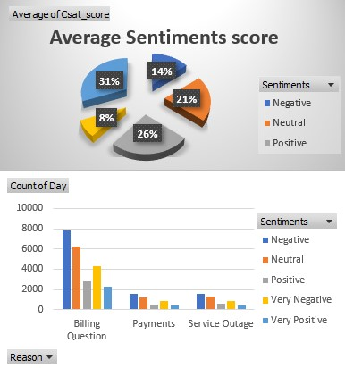
Customer Sentiment Analysis
Suggestions to decrease the negative -:
Encourage delegates to use polite language. For example, they might say, "Let's see how I can help."
Processes such as acknowledging the customer's complaint, apologizing, and offering solutions can be very effective.

Slide 4
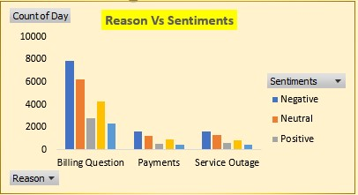
Root Cause Analysis
Suggestions -:
Provide extensive training on billing processes, common billing issues, and how to effectively explain billing details to customers.
Equip representatives with knowledge of common billing errors and how to rectify them.
Offer various payment methods to accommodate different customer preferences, such as credit/debit cards, bank transfers, online payment platforms, and payment plans.
Offer round-the-clock support during service outages to assist customers and provide real-time updates.

Slide 5
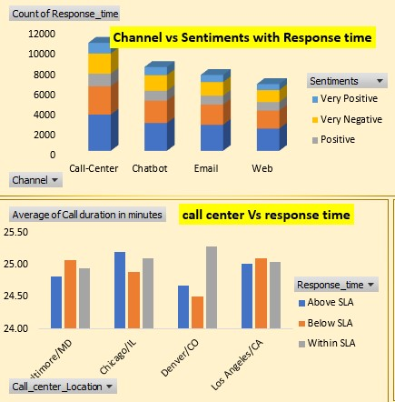
Service Response Time Analysis
Suggestions
Ensure that staffing levels are appropriate to handle call volumes efficiently. Analyze historical data to predict peak call times and adjust staffing accordingly.
Implement a call prioritization system based on the nature of the call. Urgent or high-priority calls should be handled first.
Use call routing technology to direct calls to the most appropriate agents based on skillset and availability.
Utilize call queuing systems to hold callers in a queue until an agent becomes available.
Provide estimated wait times to manage caller expectations and reduce frustration.

Slide 6
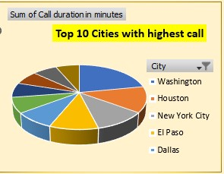
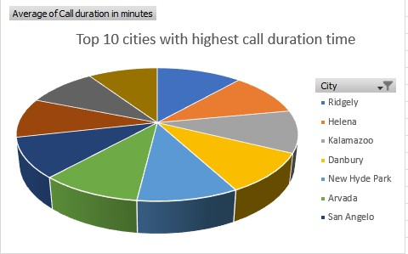
Customer Segmentation
Suggestions
Segment Customers based on the Gender as Different genders may have different preferences or Needs
Segment customers based on where they are living , segments based on cities.
Segmentation based on call durations.

Slide 7
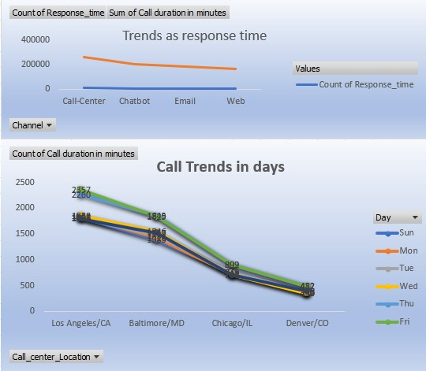
Trends and Patterns Identification
Suggestions
Analyze call volume patterns over different time periods (daily, weekly, monthly, seasonal) to identify peak times and plan staffing accordingly.
Categorize calls based on the reason for contact (e.g., billing inquiries, technical support, product information).
Monitor trends in SLA compliance to ensure that service level targets are being met.

Slide 8
Thank You

